Slide 1
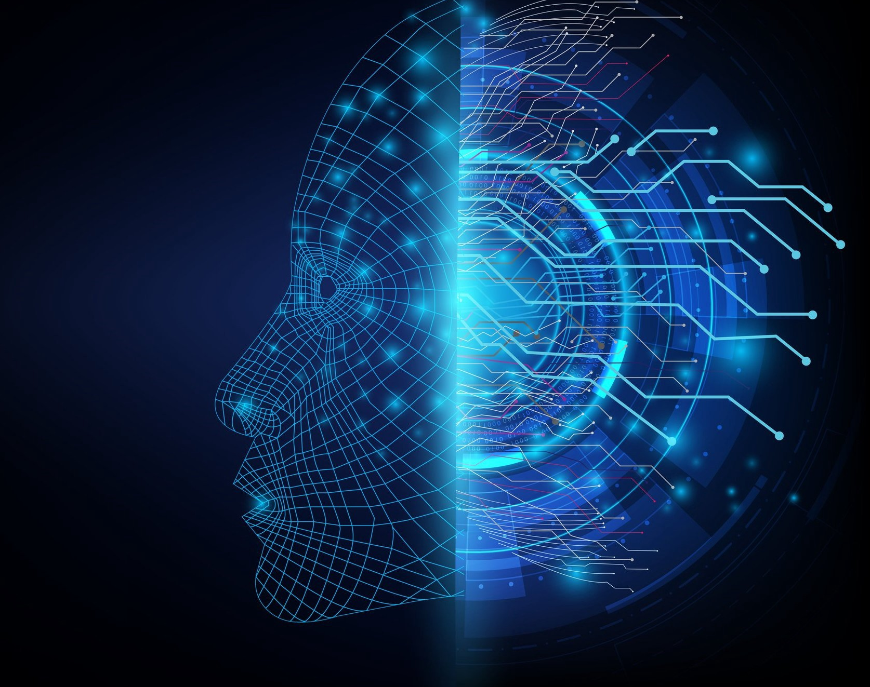
Artificial Intelligence and Machine Learning

Slide 2
Agenda
Intro of AI / ML
Intro of Google Colab
Intro of TensorFlow 2.x
Practical
Convert Celsius to Farhnite
Image Classification with Fashion MNIST dataset

Slide 3
Example of AI / ML
Recommendation engines
Google Search
Amazon Prime
Netflix
Self Driving Cars
Gamified Learning and Education
Chess
Ludo
Face Detection
https://builtin.com/artificial-intelligence/machine-learning-examples-applications

Slide 4
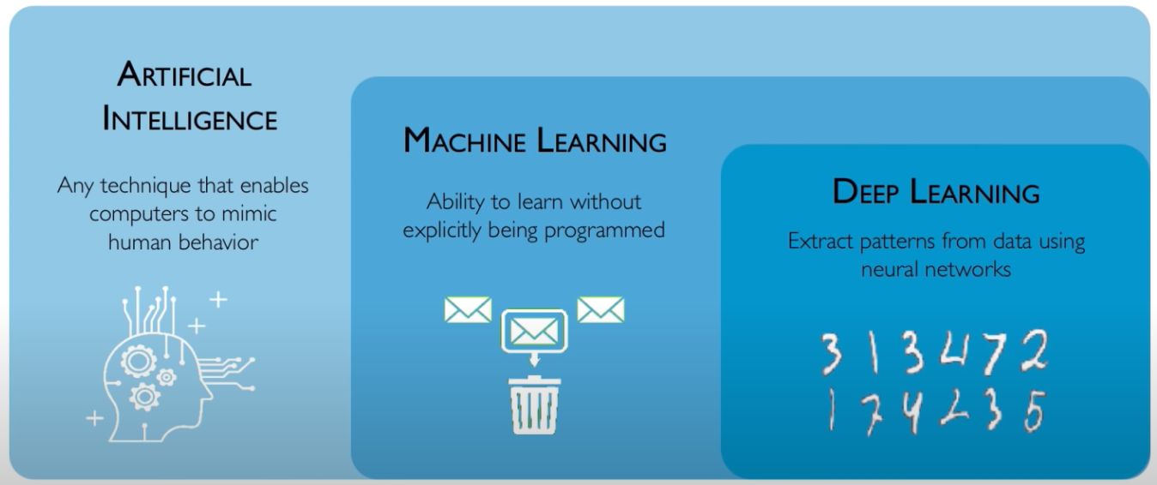
What is AI / ML ?
https://www.youtube.com/watch?v=njKP3FqW3Sk&list=PLtBw6njQRU-rwp5__7C0oIVt26ZgjG9NI

Slide 5
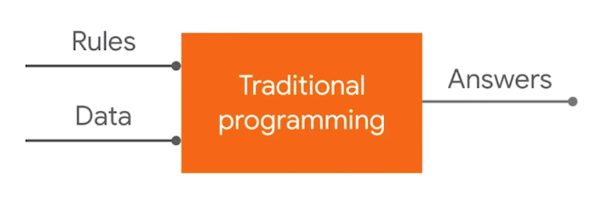
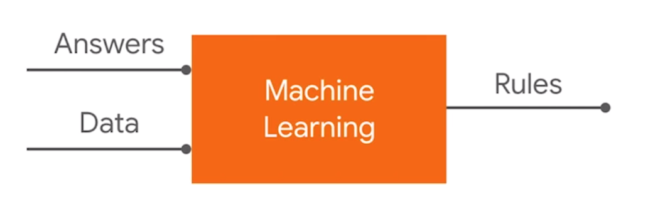
What is Machine Learning ?

Slide 6
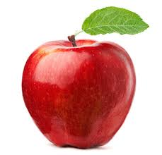
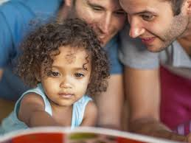
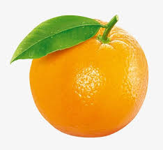
What is Machine Learning ?
https://www.youtube.com/watch?v=KNAWp2S3w94&feature=emb_logo

Slide 7


Slide 8
What is TensorFlow?
TensorFlow is an end-to-end open source platform for machine learning.

Slide 9

What is TensorFlow?
A multidimensional array
A graph of operations

Slide 10
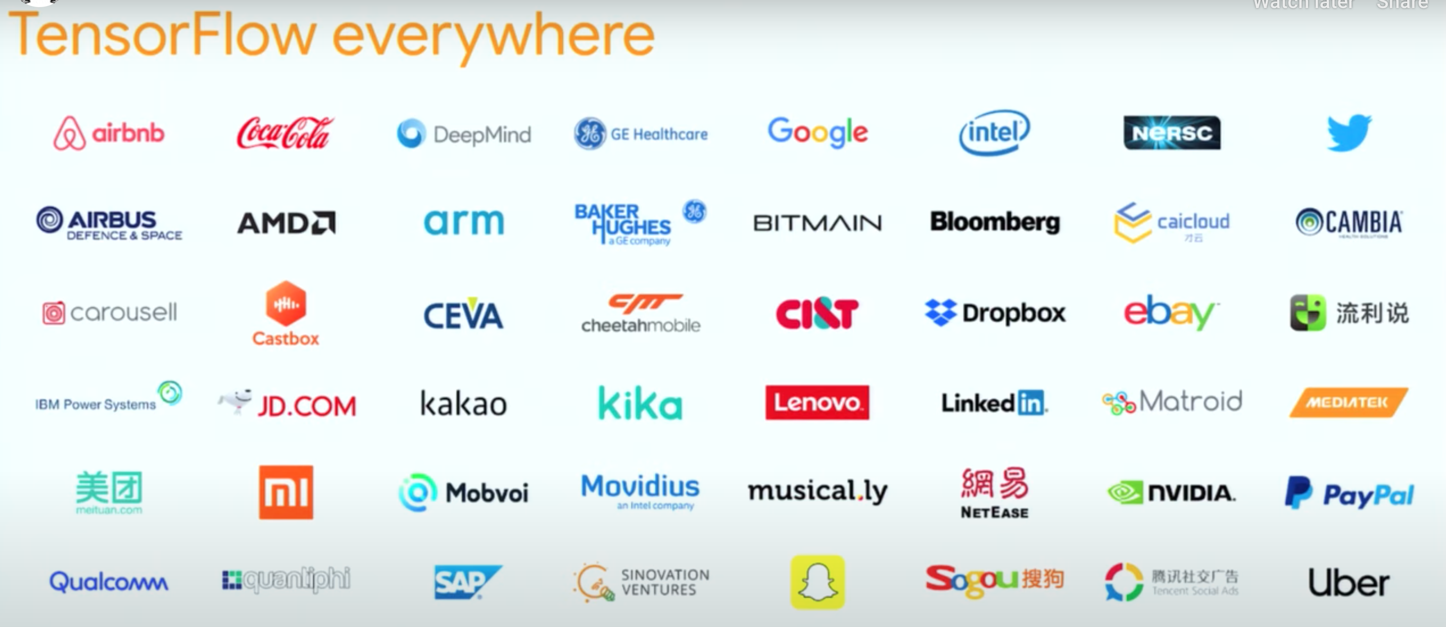

Slide 11
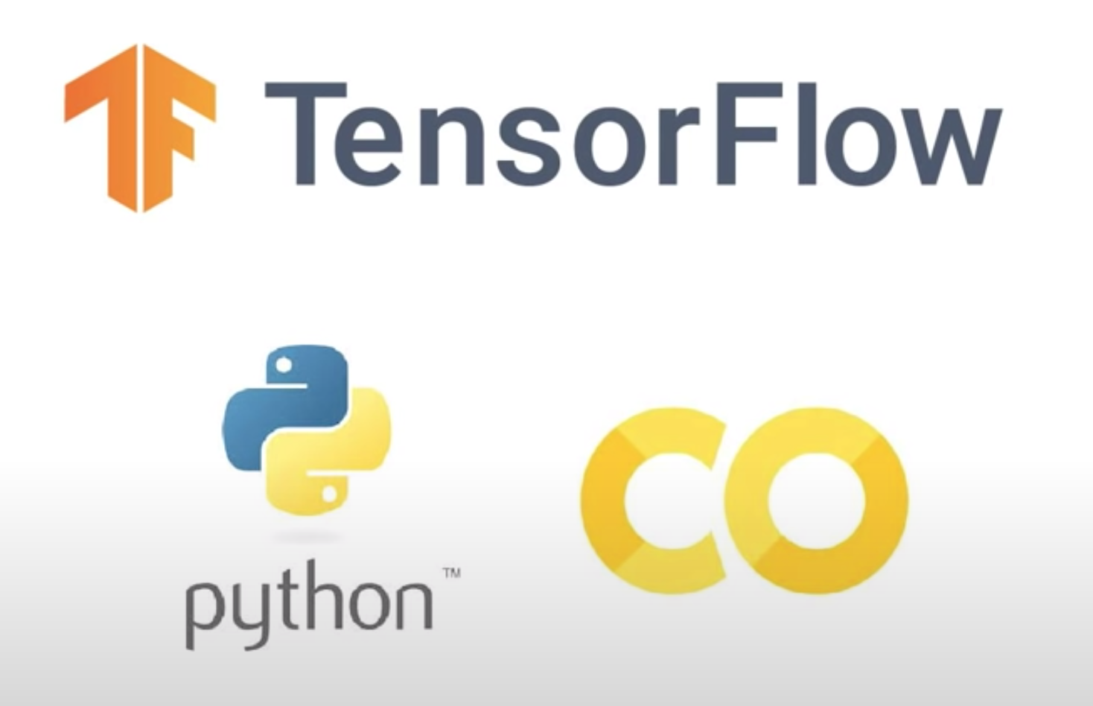

Slide 12
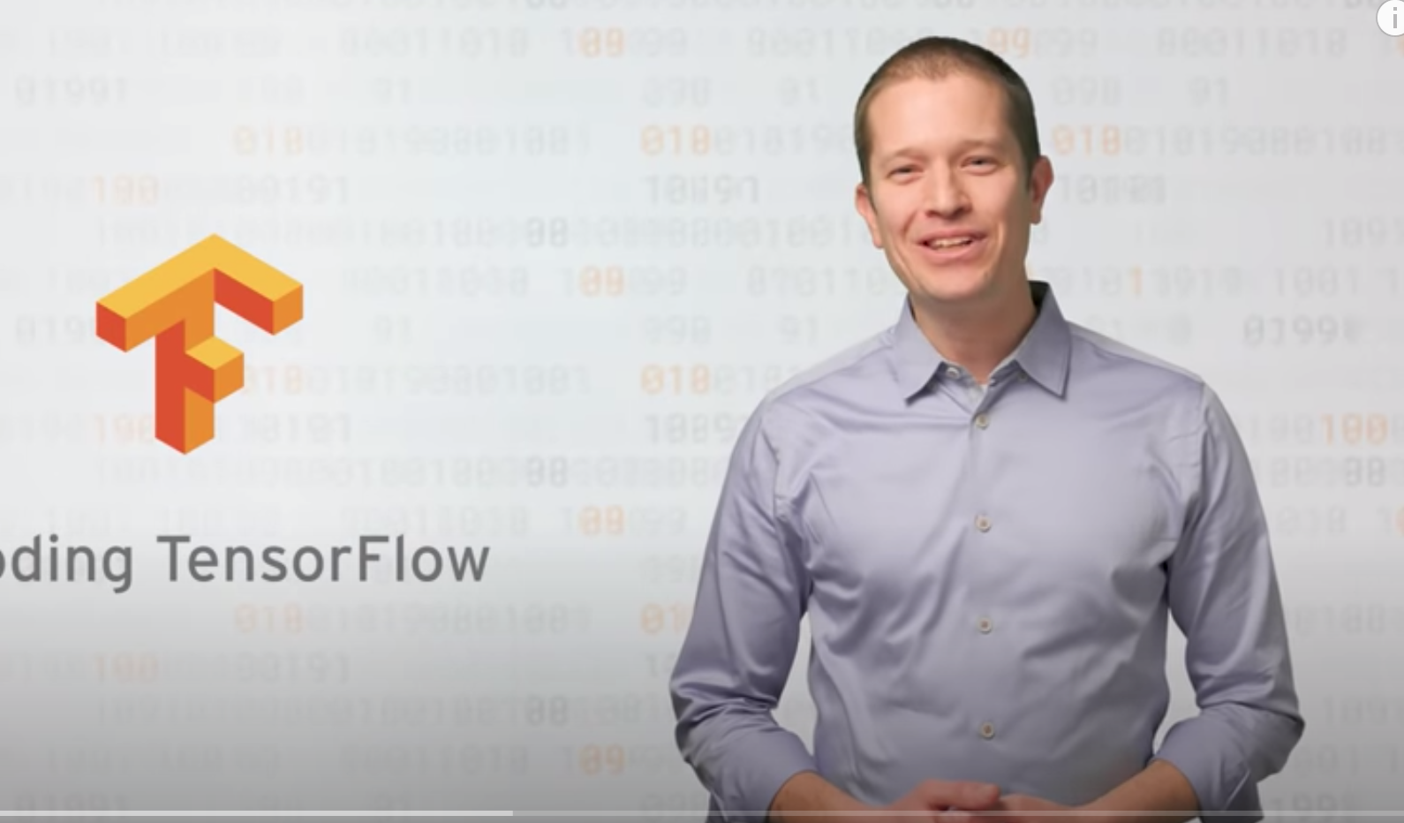

https://www.youtube.com/watch?v=inN8seMm7UI

Slide 13
Celsius to Fahrenheit Problem
Traditional Programming
Input: -40, -10, 0, 8, 15, 22, 38
Output: -40, 14, 32, 46, 59, 72, 100
Formula: input * 9/5 + 32

Slide 14
Celsius to Fahrenheit Problem
Machine Learning
Input: -40, -10, 0, 8, 15, 22, 38
Output: -40, 14, 32, 46, 59, 72, 100
Formula: input * 9/5 + 32

Slide 15
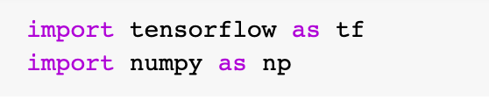
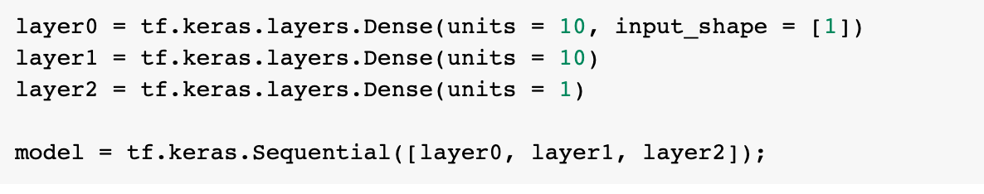
Celsius to Fahrenheit Problem
Machine Learning
Import Required Library
Input & Output
Create Model
https://github.com/DineshChopra/AI-ML/blob/master/TensorFlow/Udacity/1_CelsisusToFahrenheite.ipynb

Slide 16
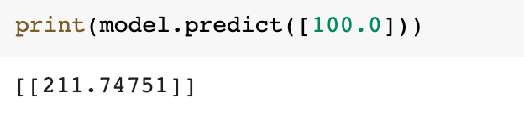
Celsius to Fahrenheit Problem
Machine Learning
Compile Model
Train Model
Predict Model
https://github.com/DineshChopra/AI-ML/blob/master/TensorFlow/Udacity/1_CelsisusToFahrenheite.ipynb

Slide 17
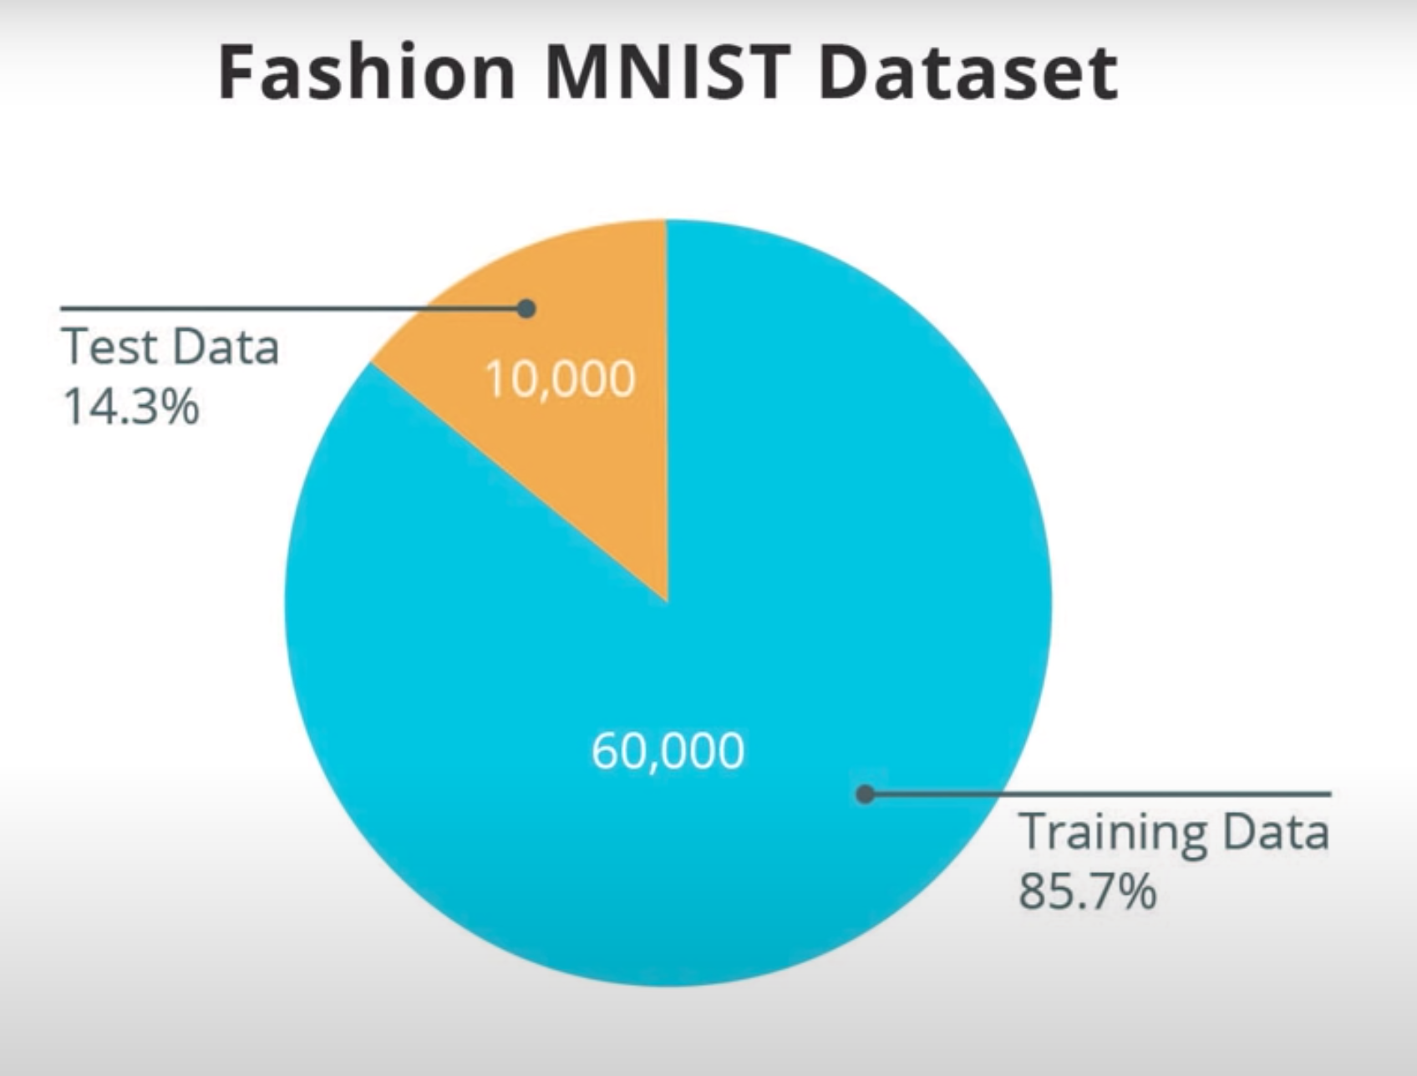
Total Images:70,000 Image Size: 28 * 28 Pixel Grey Scale Images

Slide 18
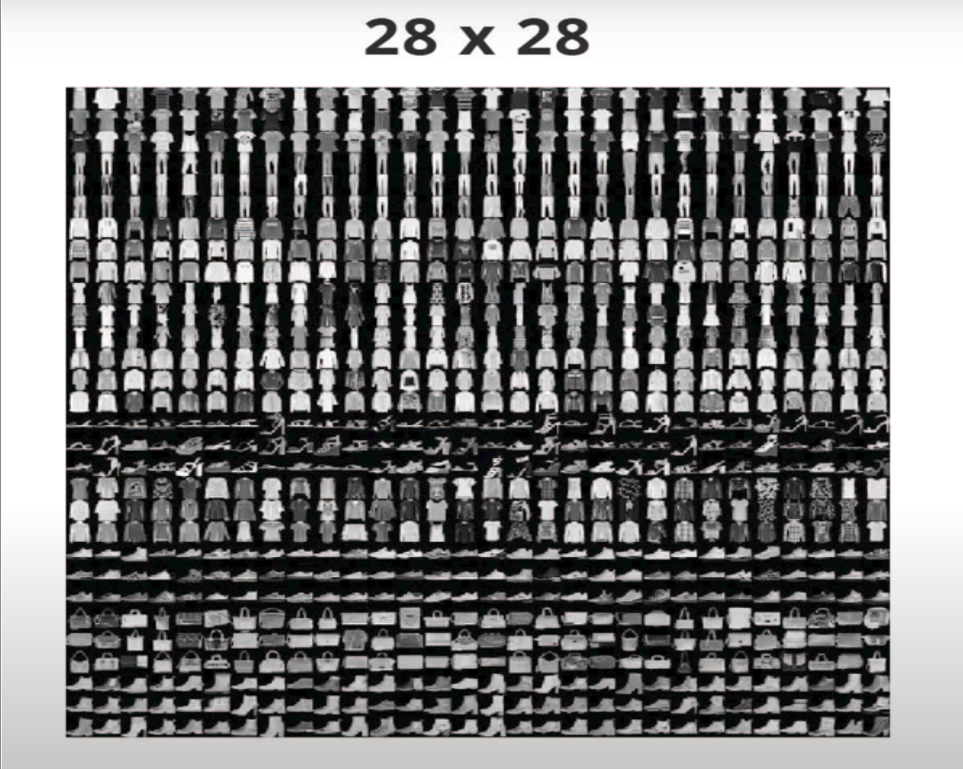
Fashion MNIST Dataset
https://colab.research.google.com/github/tensorflow/docs/blob/master/site/en/tutorials/keras/classification.ipynb#scrollTo=9ODch-OFCaW4

Slide 19
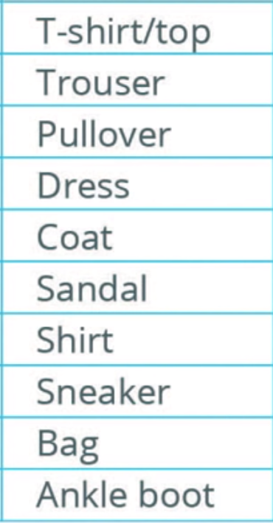
Fashion MNIST Dataset
https://colab.research.google.com/github/tensorflow/docs/blob/master/site/en/tutorials/keras/classification.ipynb#scrollTo=9ODch-OFCaW4

Slide 20
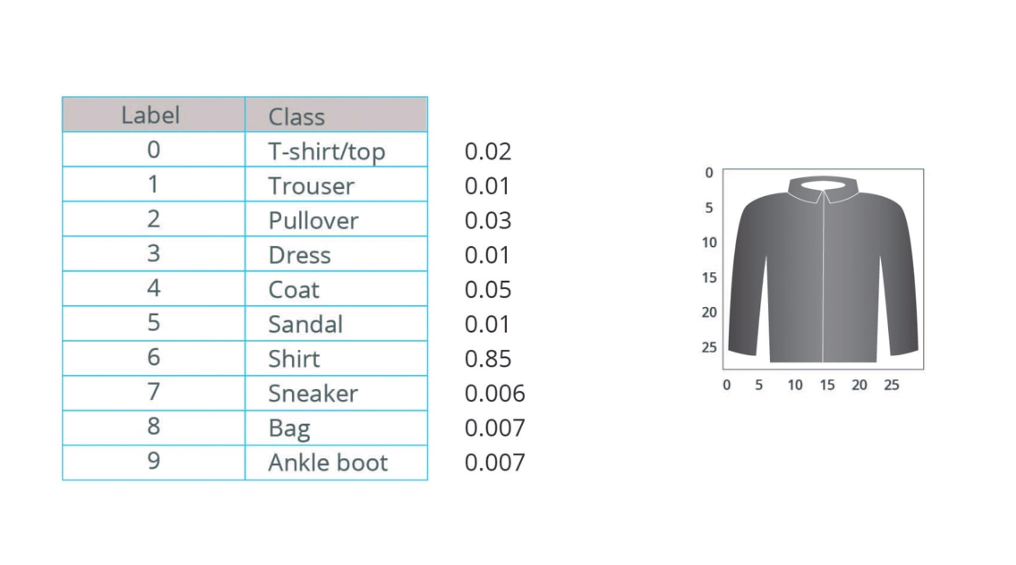
Fashion MNIST Dataset
https://colab.research.google.com/github/tensorflow/docs/blob/master/site/en/tutorials/keras/classification.ipynb#scrollTo=9ODch-OFCaW4

Slide 21
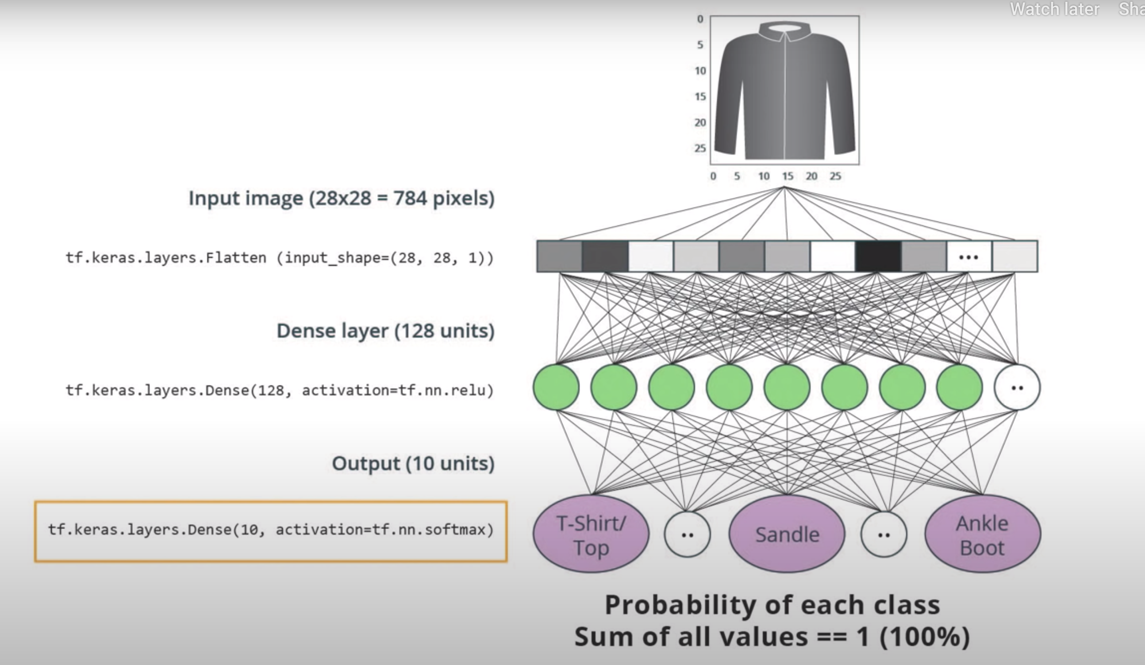

Slide 22
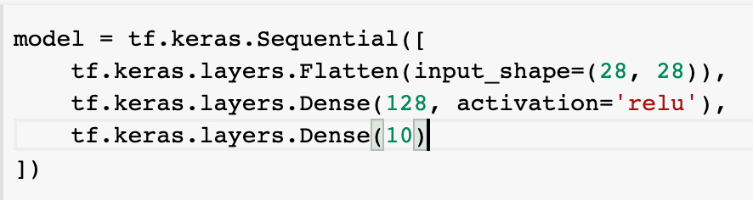
Create Model
Compile Model

Slide 23
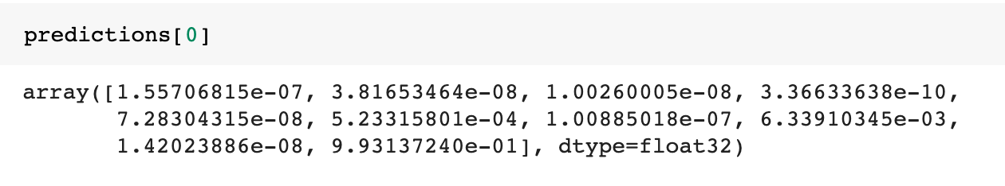
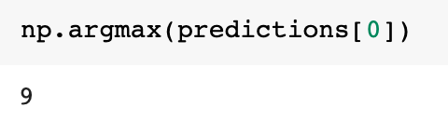
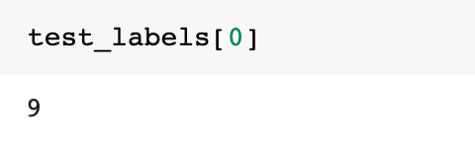
Train Model
Make Predictions

Slide 24


Resources
Tutorial
https://www.tensorflow.org/tutorials/keras/classification
https://colab.research.google.com/github/tensorflow/docs/blob/master/site/en/tutorials/keras/classification.ipynb#scrollTo=9ODch-OFCaW4
https://www.udacity.com/course/intro-to-tensorflow-for-deep-learning--ud187
Free Course
How Neural Network Works ?
https://www.youtube.com/playlist?list=PLZHQObOWTQDNU6R1_67000Dx_ZCJB-3pi
MIT Introduction to Deep Learning | 6.S191
https://www.youtube.com/watch?v=njKP3FqW3Sk&list=PLtBw6njQRU-rwp5__7C0oIVt26ZgjG9NI

Slide 25


